Slide 1

GLOBAL INFLATION
Data 230 : Group 3
Project Presentation By:
Iram Khan
Madhur Parakh
Yasaman Emami

Slide 2
Inflation
What is inflation?
  Rise in price of goods and services in an economy over time
What is the impact of Inflation, deflation, and disinflation ?
What are the factors affecting Inflation in last few decades ?

Slide 3
Global Inflation Database
Using the Global Database of Inflation from The World Bank website
1st Dataset having multiple sheets consists :
+ Inflation Data with Time period: 1970-2021
+ 196 countries; up to 37 advanced economies and 159 EMDEs and LICs
+ six inflation measures present at both quarterly and annual level
      headline,
      core,
      food,
      energy CPI
      PPI
      GDP deflator

Slide 4
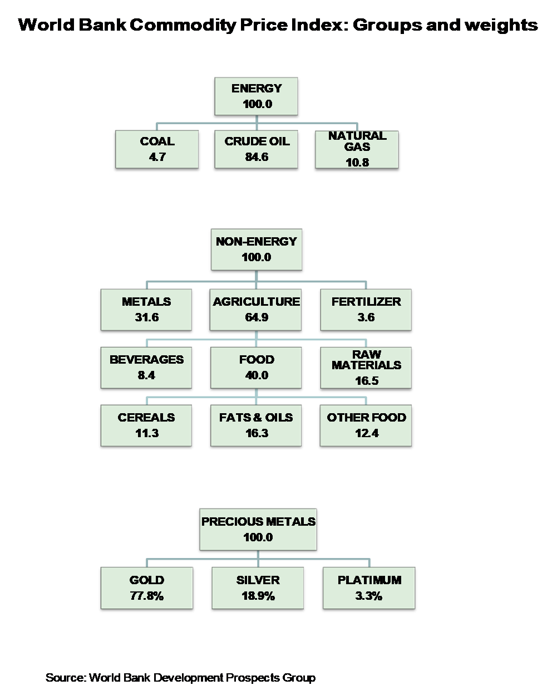
2nd Dataset consists of Energy, Non-Energy and Metal commodities indices, prices and weights details for the same time period
Global Inflation Database

Slide 5
Data Preprocessing & Transformation done using Python :
Missing Values replaced with 0 and Unknown
Merged data from 5 different worksheets(for all inflation types) of 1st dataset file to transform to 2 final excel files, one each for annual and quarterly inflation data
Final excel files contain 48553 records for annual file having inflation percentage change and 143706 records for quarterly file having indices
Updated some formatting for the Commodity data file that contain 5 sheets having Real and Nominal Commodities prices and indices
Added a new column - Economy type, to group all the given countries into Advanced Economies, Emerging Market Developing Economies(EMDEs) and Lower Income Countries(LICs) in both the final files

Slide 6
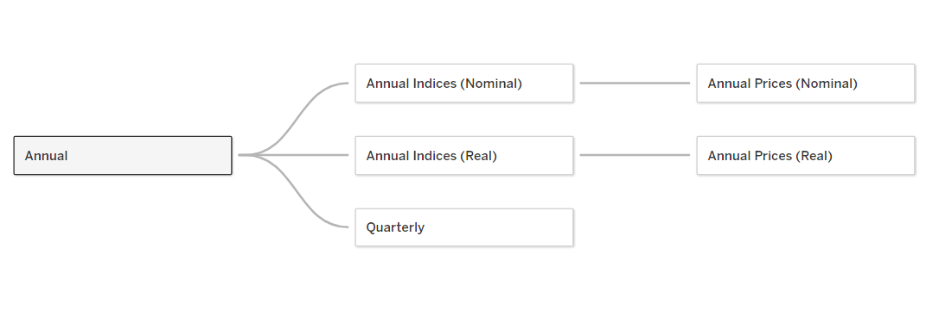
Data Modelling :
Combining multiple sheets from 3 final datasets using required common fields

Slide 7
Changes in Global Inflation over time (1970-2020):
Did recession has affected the Inflation globally?
What the changes in different Commodities prices affected the inflation ?
What Top N countries had highest percentage of Inflation for different Years?
What Top N countries had highest percentage of Inflation for different Years?

Slide 8
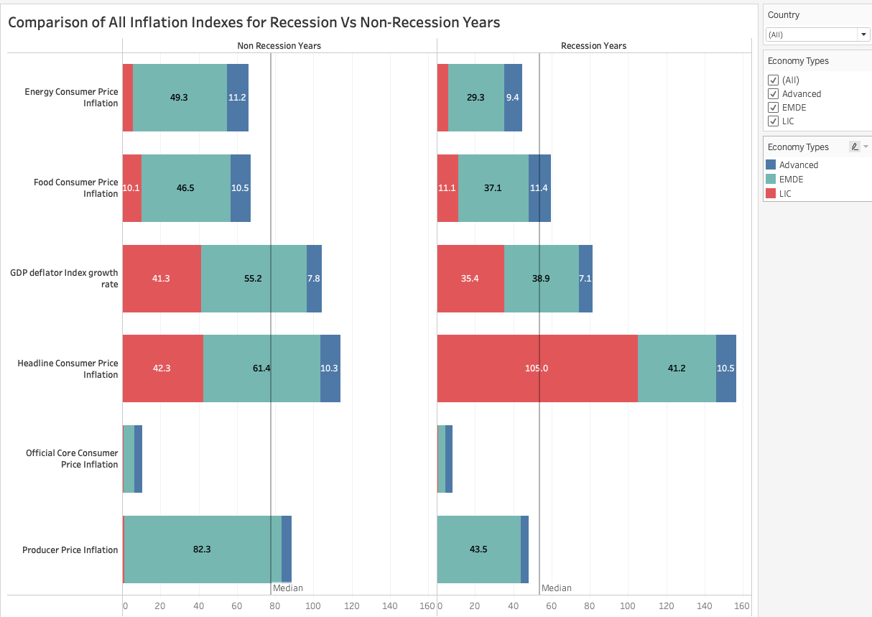
Did recession has affected the Inflation globally?

Slide 9
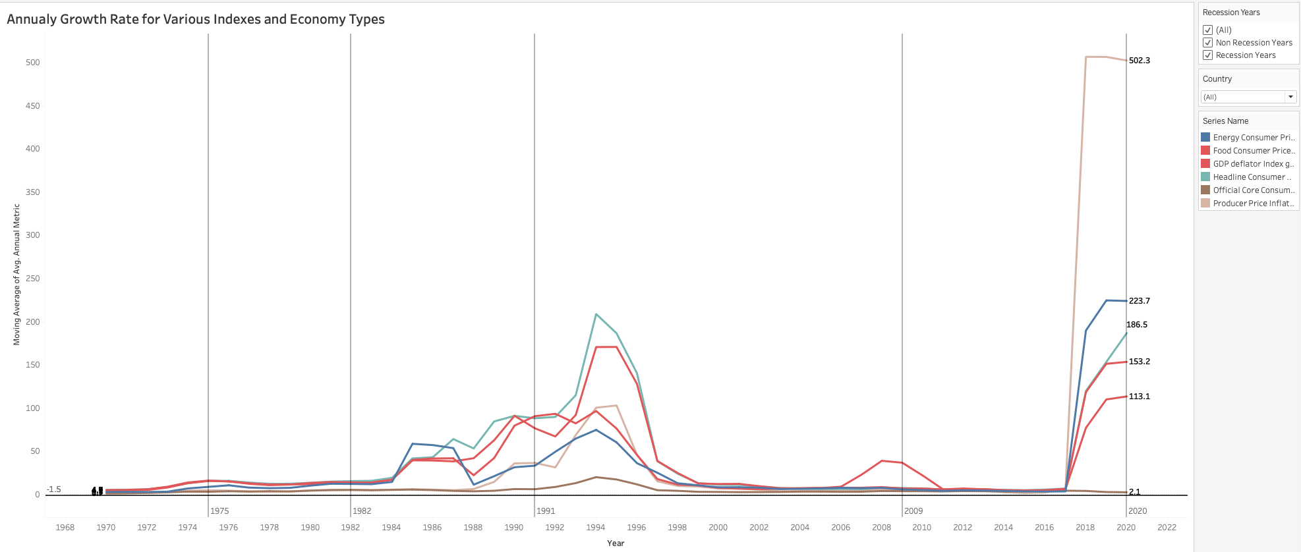
How different indexes and inflation was during recession years?

Slide 10
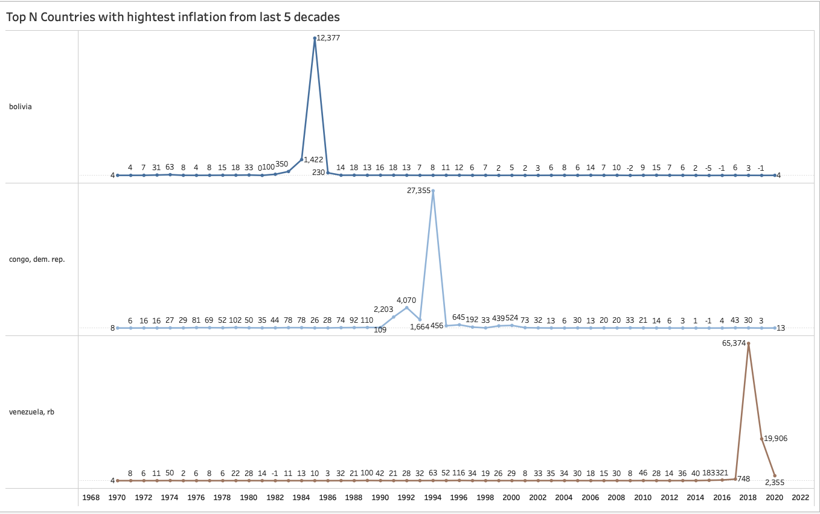
What Top N countries had highest percentage of Inflation for different Years?

Slide 11
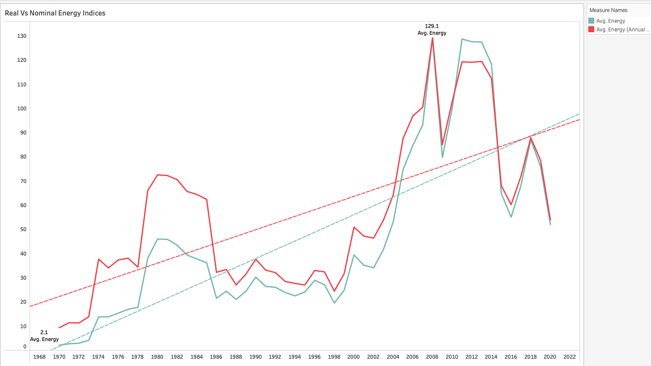
Real VS Nominal Energy Index - How commodities prices get affected due to Inflation

Slide 12
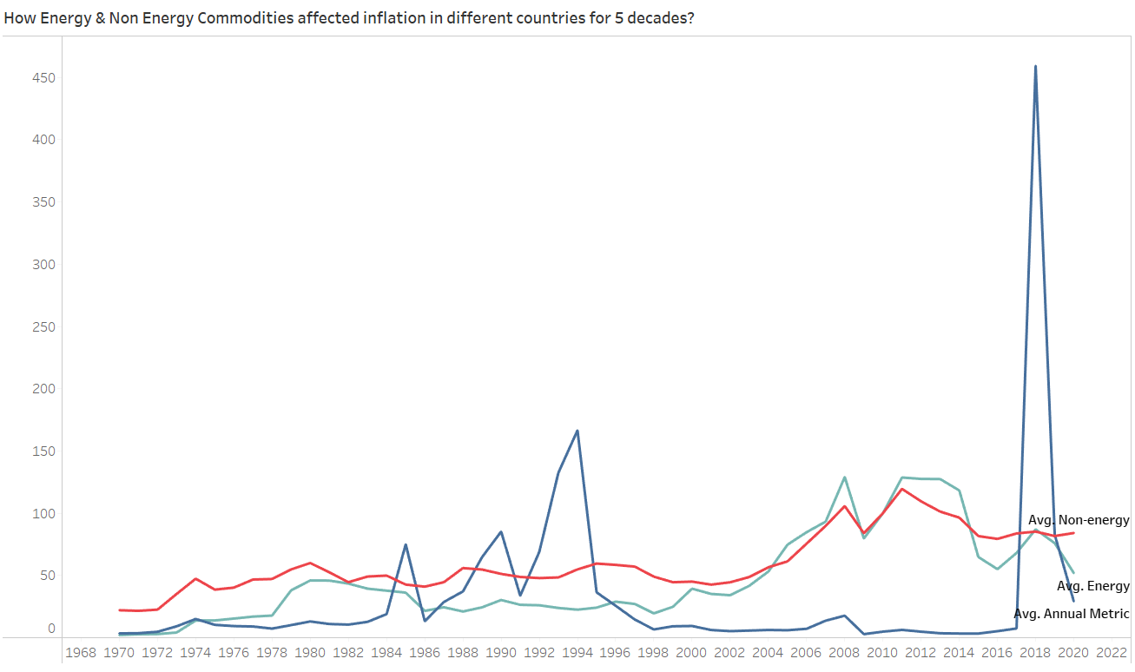
What the changes in different Commodities prices affected the inflation ?

Slide 13
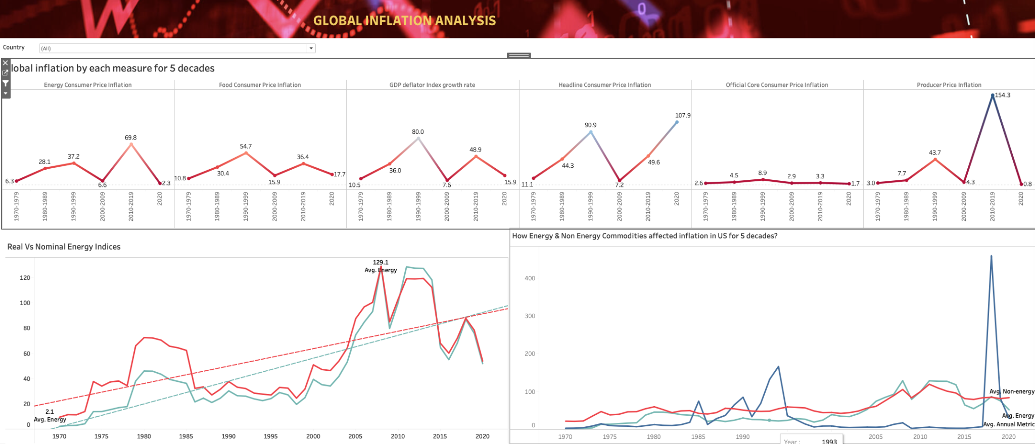
Dashboard - 1:

Slide 14
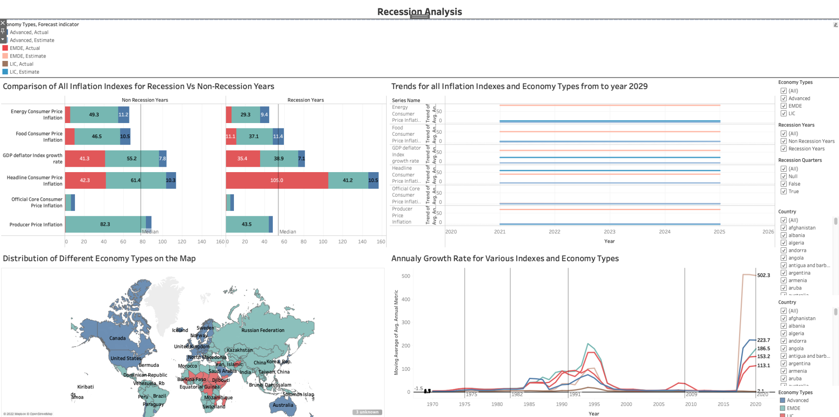
Dashboard - 2:

Slide 15
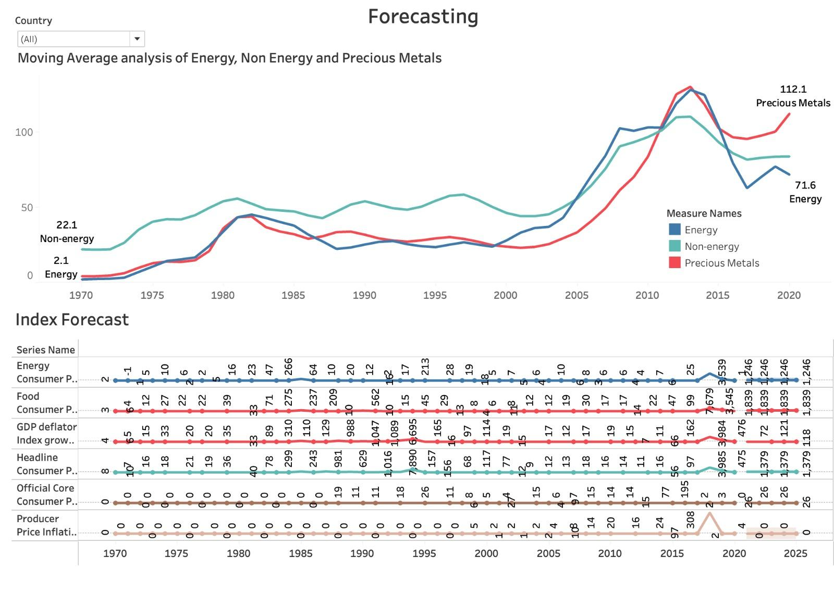
Dashboard-3:

Slide 16
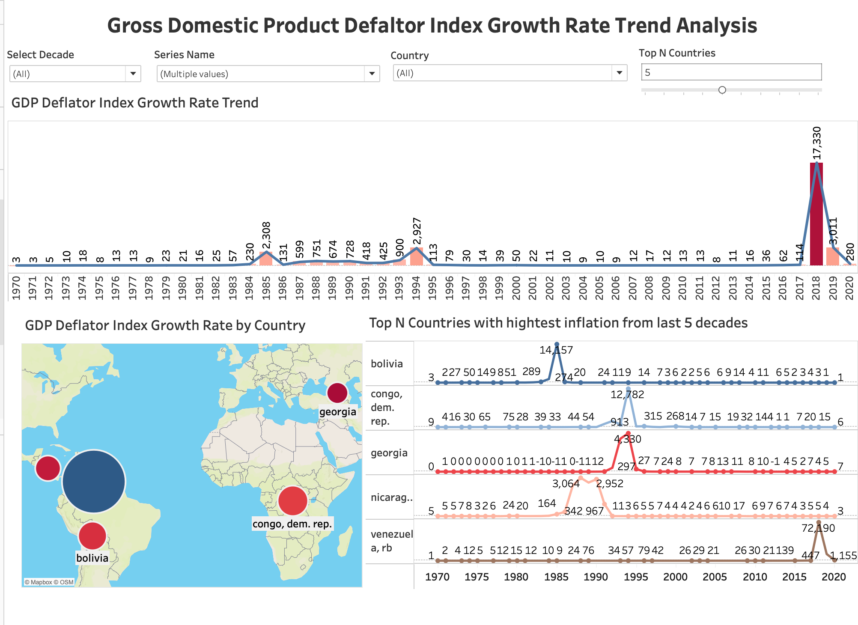
Dashboard- 4 :

Slide 17
Thank You

Slide 18
References
https://www.worldbank.org/en/research/brief/inflation-database#:~:text=
The%20World%20Bank's%20Prospects%20Group,consumer%20price%20index%20(CPI)%20inflation

